Slide 1
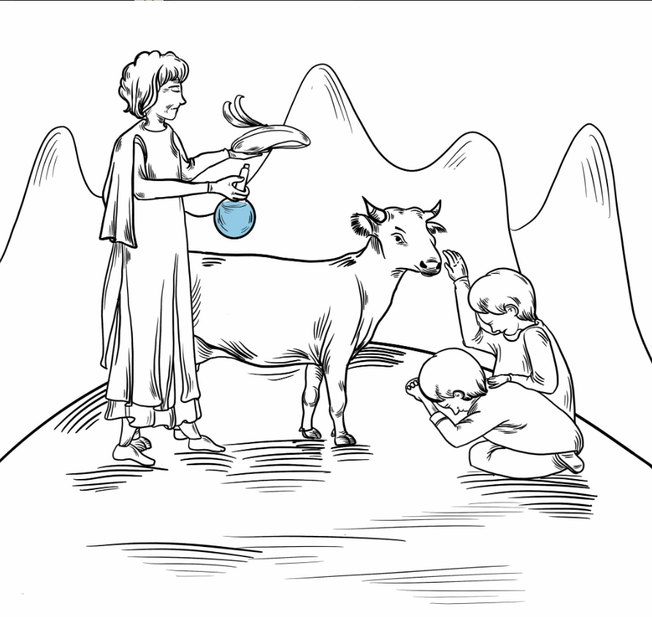
Data Science for Design
Survey of Scottish Witchcraft
Group 14
Chung Yan Lee
Groza Daniela
Huizhi Zhang
Jingyin Liang
Shan Ouyang
Tutor： DADZIE Aba-Sah

Slide 2
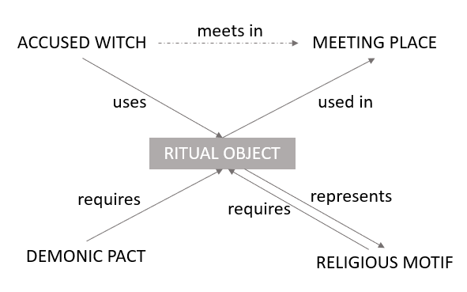
INTRODUCTION
Database: Includes information about accused witches, cases, trails
Motivation: Focus on the ritual object, and explore the inner relationships

Slide 3

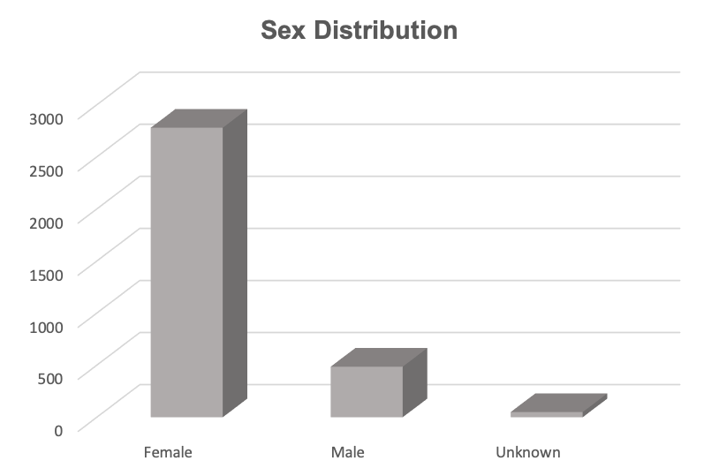
DATA ANALYSIS
Bar Chart
Accused (witches)
Ritual Object
Meeting Place
Demonic Pact
Religious Motif

Slide 4
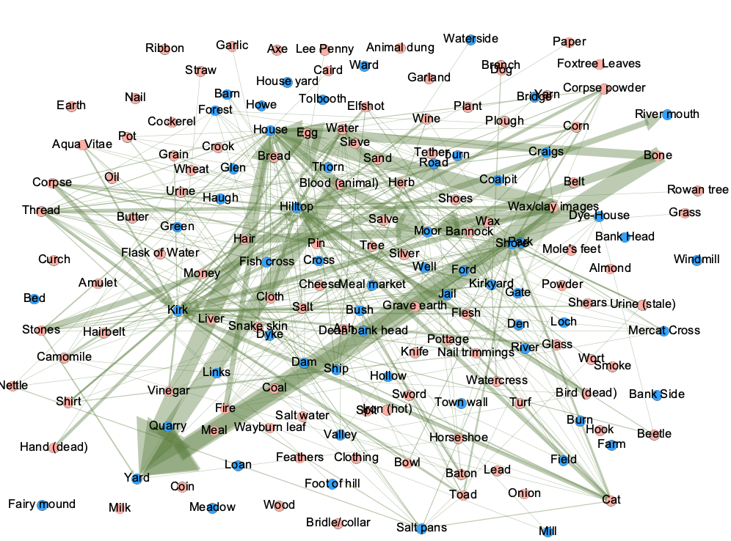

DATA ANALYSIS
Bar Chart & Network
Meeting Place
Ritual Object
Demonic Pact
Religious Motif
If there are more case have the same ritual objects and the meeting place, the arrow would the bigger.

Slide 5
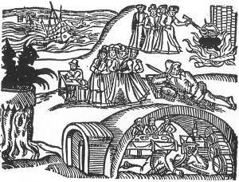
DESIGN: BOOKLET
The style of our illustration
The 10 representative cases:
C/EGD/1605: most frequently or common meeting place, Demonic and Motifs in all cases
C/EGD/63: the most ritual objects from all the cases
C/EGD/59: the unique ritual object "mole's feet"
C/EGD/2141: most Motifs
C/EGD/166: the most number of meeting place
C/EGD/1747: the most Demonic Pact
C/EGD/1748: youngest male to be accused of witchcraft aged 16
C/JO/3059: all the relationship(has all the values without NaN), and it has unique ritual objects "Hand (dead)" and “Rowan tree”
C/EGD/882: has the unique religious motif "Sign of the cross"
C/EGD/160: has the unique ritual object and motif "flask of water"
Credit: Survey of Scottish Witchcraft Database http://witches.shca.ed.ac.uk/

Slide 6
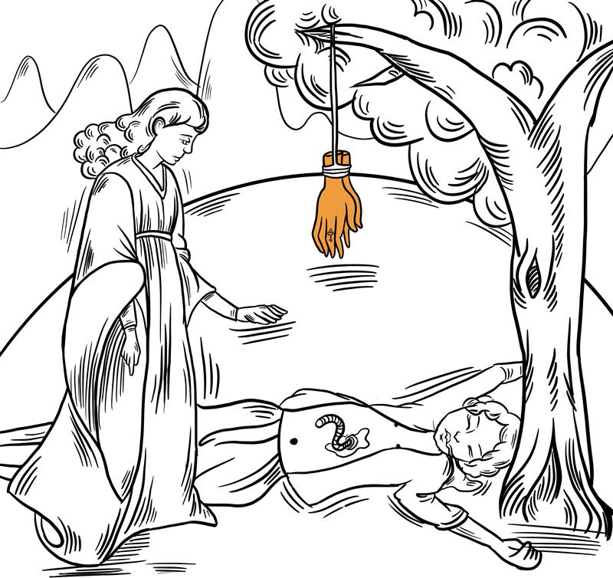



ILLUSTRATION
https://www.flipsnack.com/SurveyofScottishWitchcraft/witchcraft-booklet.html
Emphasized items in cases
Highlighted in illustrations
All the Illustrations are the visualization of data
Eg. The religious motif "Sign of cross"

Slide 7
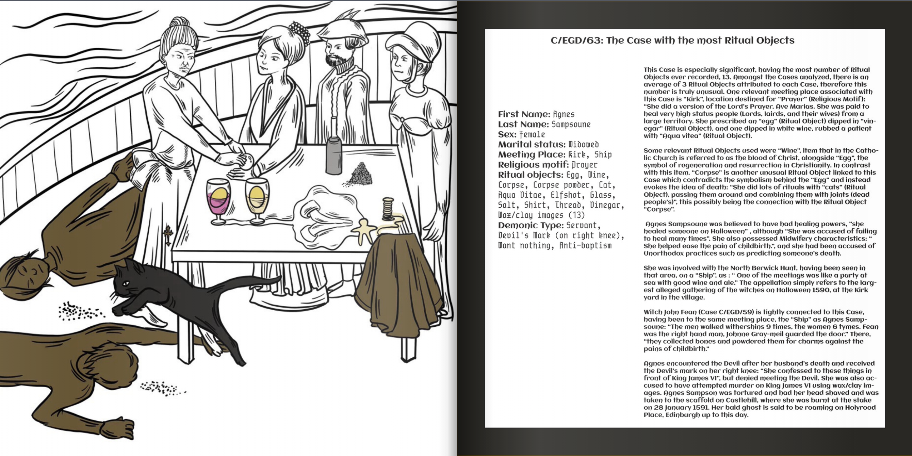
Example 1

Slide 8
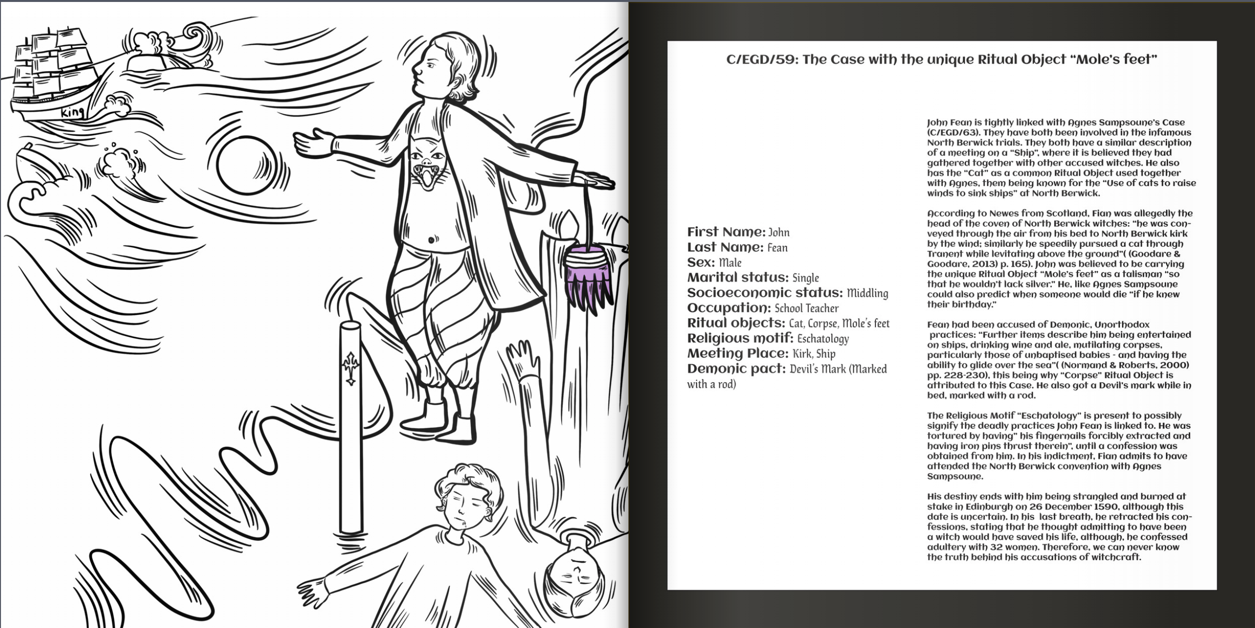
Example 2

Slide 9
FURTHER WORK
Pop-up book
Online Interactive website
ITERATION
More than 10 cases
Board game
Booklet

Slide 10
THANK FOR WATCHING!

